Slide 1
Theme Colors Tool*
Dark 1
Dark 2
Accent
1
Accent
2
Accent
3
Accent
4
Accent
5
Accent
6
Dark 1
Light 1
Click the standard shapes below to see examples
Smart
Art
Rectangle
Rounded Rectangle
Oval/Circle
Callout
Button
Light 2
*Change Colors
> Design Tab > Variants > Colors > Select premade set or click Customize Colors to create your own palette
Light 1

Slide 2
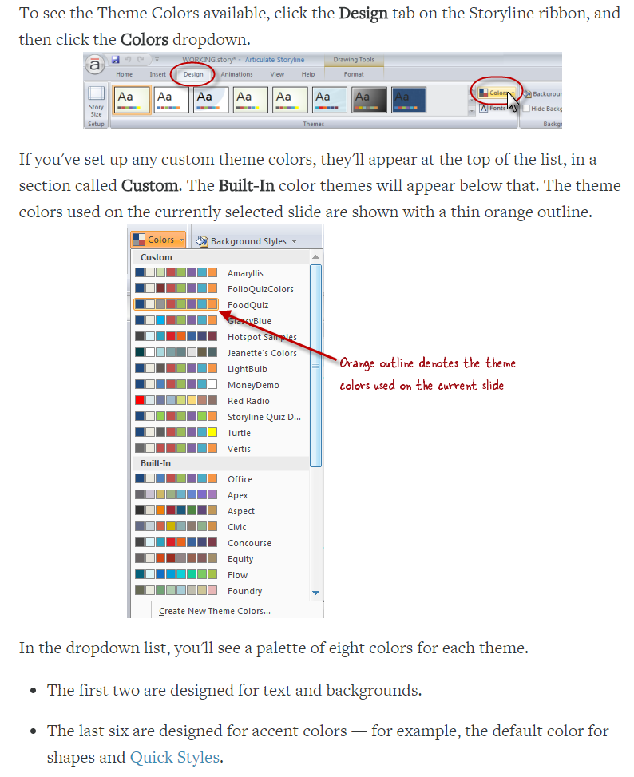
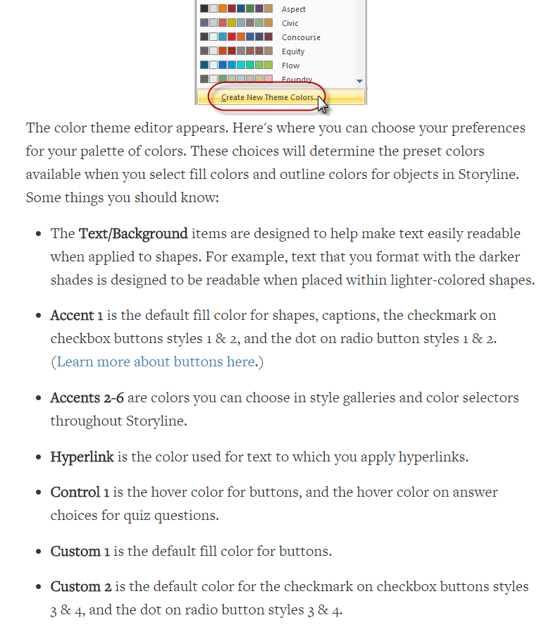
Theme Color Information
Accent 1
Accent 2
Accent 3
Accent 4
Accent 5
Accent 6
20%
100%
20%
100%
20%
100%
20%
100%
20%
100%
20%
100%
40%
125%
40%
125%
40%
125%
40%
125%
40%
125%
40%
125%
60%
150%
60%
150%
60%
150%
60%
150%
60%
150%
60%
150%

Slide 3
Full Theme Color Range
Lighter 80%
Lighter 80%
Lighter 80%
Lighter 80%
Lighter 80%
Lighter 80%
Lighter 80%
Lighter 80%
Lighter 60%
Lighter 60%
Lighter 60%
Lighter 60%
Lighter 60%
Lighter 60%
Lighter 60%
Lighter 60%
Lighter 40%
Lighter 40%
Lighter 40%
Lighter 40%
Lighter 40%
Lighter 40%
Lighter 40%
Lighter 40%
100%
100%
100%
100%
100%
100%
100%
100%
Darker 25%
Darker 25%
Darker 25%
Darker 25%
Darker 25%
Darker 25%
Darker 25%
Darker 25%
Darker 50%
Darker 50%
Darker 50%
Darker 50%
Darker 50%
Darker 50%
Darker 50%
Darker 50%

Slide 4
Rectangle
Outlined
Outlined
Outlined
Outlined
Outlined
Outlined
Outlined
Outlined
Color Filled
Color Filled
Color Filled
Color Filled
Color Filled
Color Filled
Color Filled
Color Filled
Filled, light border
Filled, light border
Filled, light border
Filled, light border
Filled, light border
Filled, light border
Filled, light border
Filled, light border
Subtle
Subtle
Subtle
Subtle
Subtle
Subtle
Subtle
Subtle
Moderate
Moderate
Moderate
Moderate
Moderate
Moderate
Moderate
Moderate
Intense
Intense
Intense
Intense
Intense
Intense
Intense
Intense

Slide 5
Rounded Rectangle
Outlined
Outlined
Outlined
Outlined
Outlined
Outlined
Outlined
Outlined
Color Filled
Color Filled
Color Filled
Color Filled
Color Filled
Color Filled
Color Filled
Color Filled
Filled, light border
Filled, light border
Filled, light border
Filled, light border
Filled, light border
Filled, light border
Filled, light border
Filled, light border
Subtle
Subtle
Subtle
Subtle
Subtle
Subtle
Subtle
Subtle
Moderate
Moderate
Moderate
Moderate
Moderate
Moderate
Moderate
Moderate
Intense
Intense
Intense
Intense
Intense
Intense
Intense
Intense

Slide 6
Oval/Circle
Outlined
Outlined
Outlined
Outlined
Outlined
Outlined
Outlined
Outlined
Color Filled
Color Filled
Color Filled
Color Filled
Color Filled
Color Filled
Color Filled
Color Filled
Filled, light border
Filled, light border
Filled, light border
Filled, light border
Filled, light border
Filled, light border
Filled, light border
Filled, light border
Subtle
Subtle
Subtle
Subtle
Subtle
Subtle
Subtle
Subtle
Moderate
Moderate
Moderate
Moderate
Moderate
Moderate
Moderate
Moderate
Intense
Intense
Intense
Intense
Intense
Intense
Intense
Intense

Slide 7
Callouts
Outlined
Outlined
Outlined
Outlined
Outlined
Outlined
Outlined
Outlined
Color Filled
Color Filled
Color Filled
Color Filled
Color Filled
Color Filled
Color Filled
Color Filled
Filled, light border
Filled, light border
Filled, light border
Filled, light border
Filled, light border
Filled, light border
Filled, light border
Filled, light border
Subtle
Subtle
Subtle
Subtle
Subtle
Subtle
Subtle
Subtle
Moderate
Moderate
Moderate
Moderate
Moderate
Moderate
Moderate
Moderate
Intense
Intense
Intense
Intense
Intense
Intense
Intense
Intense

Slide 8
Action Buttons

Slide 9
Smart Art 1
Page 1
Page 2
Page 3
Label 1
Label 2
Label 3
Label 4
Step 1
Step 2
Step 3
Step 4
Label 1
Label 2
Label 3
Label 4
Supporting text
Supporting text
Supporting text
Supporting text
Label 1
Label 2
Label 3
Label 4
Supporting text
Supporting text
Supporting text
Supporting text
Label 1
Label 2
Label 3
Label 4
Supporting text
Supporting text
Supporting text
Supporting text
Label 1
Label 2
Label 3
Label 4
Supporting text
Supporting text
Supporting text
Supporting text

Slide 10
Smart Art 2
Page 1
Page 2
Page 3
Label 1
Label 2
Label 3
Supporting text
Supporting text
Supporting text
Label 1
Supporting text 1
Supporting text 2
Supporting text 3
Main point
Supporting text 1
Supporting text 2
Supporting text 3
Supporting text 4
Supporting text 5
Label 1
Label 2
Label 3
Supporting text
Supporting text
Supporting text
Label 1
Label 2
Label 3
Label 4
Supporting text
Supporting text
Supporting text
Supporting text

Slide 11
Smart Art 3
Page 1
Page 2
Page 3
Label 1
Label 2
Label 3
Label 4
L1 Bullet
L2 Bullet
L3 Bullet
L4 Bullet
Subtext
Subtext
L1 Bullet
Sub bullet
Subtext
Sub bullet
Subtext
L2 Bullet
Subtext
Sub bullet
Subtext
L3 Bullet
Subtext
Sub bullet
Subtext
L4 Bullet
Sub Sub bullet
Sub Sub bullet
Label 1
Label 2
Label 3
Label 4
L1 Bullet
L2 Bullet
L3 Bullet
L4 Bullet
Subtext
Subtext
L1 Bullet
Sub bullet
Subtext
Sub bullet
Subtext
L2 Bullet
Subtext
Sub bullet
Subtext
L3 Bullet
Subtext
Sub bullet
Subtext
L4 Bullet
Sub Sub bullet
Sub Sub bullet

Slide 12
Light 1 on Dark 1 background
Light 1
Light 2
Dark 1 text, Light 1 bg
Dark 1
Dark 2
Dark 1 text, Light 1 bg
Light 2 background with Dark 2 Text
Light 2 background with Dark 2 Text
Light 2 background with Dark 2 Text
Light 2 background with Dark 2 Text
Dark 2 background with Light 2 Text
Dark 2 background with Light 2 Text
Dark 2 background with Light 2 Text
Dark 2 background with Light 2 Text

